Slide 1
Cryptography and Network Security
Overview & Chapter 1
Fifth Edition
by William Stallings
Notes:
Lecture slides by Lawrie Brown for “Cryptography and Network Security”, 5/e, by William Stallings, briefly reviewing the text outline from Ch 0, and then presenting the content from Chapter 1 – “Introduction”.

Slide 2
Background
Information Security requirements have changed in recent times
traditionally provided by physical and administrative mechanisms
computer use requires automated tools to protect files and other stored information
use of networks and communications links requires measures to protect data during transmission
Notes:
The requirements of information security within an organization have undergone two major changes in the last several decades. Before the widespread use of data processing equipment,the security of information felt to be valuable to an organization was provided primarily by physical (eg. rugged filing cabinets with locks) and administrative mechanisms (eg. Personnel screening procedures during hiring process).
Growing computer use implies a need for automated tools for protecting files and other information stored on it. This is especially the case for a shared system, such as a time-sharing system, and even more so for systems that can be accessed over a public telephone network, data network, or the Internet.
The second major change that affected security is the introduction of distributed systems and the use of networks and communications facilities for carrying data between terminal user and computer and between computer and computer. Network security measures are needed to protect data during their transmission.

Slide 3
Definitions
Computer Security - generic name for the collection of tools designed to protect data and to thwart hackers.
Network Security - measures to protect data during their transmission.
Internet Security - measures to protect data during their transmission over a collection of interconnected networks.
Notes:
Here are some key definitions, note boundaries between them are blurred.

Slide 4
Security Goals
Information needs to be hidden from
Unauthorized access (Confidentiality)
Protected from unauthorized change (integrity)
Available to an authorized entity when it is needed (availability)
Security Goals
Confidentiality
Availability
Integrity

Slide 5
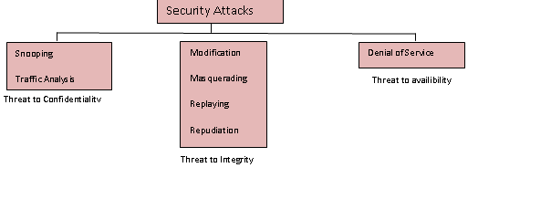
Security Attacks

Slide 6
Attacks Threatening Confidentiality
Snooping
-Unauthorized access to or interception of data.
Traffic analysis
-Can find some other type information by monitoring online traffic.
-He can find the electronic address (such as e-mail address) of the sender or the receiver.

Slide 7
Attacks Threatening Integrity
Modification
After intercepting or accessing information, the attacker modifies the information to make it beneficial to himself
Masquerading
Masquerading or spoofing(trick) happens when the attacker impersonates somebody else.
Replaying
- The attacker obtains a copy of a message sent by a user and later tries to replay it .
Repudiation
Performed by one of the two parties in the communication: the sender or the receiver.
- The sender of the message might later deny that she has sent the message.
- The receiver of the message might later deny that he has received the message

Slide 8
Attacks Threatening Availability
It may slow down or totally interrupt the service of a system.
He might send so many bogus requests to a server that the server that the server crashes because of the heavy load.
The attacker might intercept and delete a server’s response to a client, making the client to believe that the server is not responding.

Slide 9
Levels of Impact
can define 3 levels of impact from a security breach
  Low
  Moderate
  High
Notes:
We can define three levels of impact on organizations or individuals should there be a breach of security (i.e., a loss of confidentiality, integrity, or availability). These levels are defined in FIPS PUB 199:
• Low: The loss could be expected to have a limited adverse effect on organizational operations, organizational assets, or individuals. A limited adverse effect means that, for example, the loss of confidentiality, integrity, or availability might (i) cause a degradation in mission capability to an extent and duration that the organization is able to perform its primary functions, but the effectiveness of the functions is noticeably reduced; (ii) result in minor damage to organizational assets; (iii) result in minor financial loss; or (iv) result in minor harm to individuals.
• Moderate: The loss could be expected to have a serious adverse effect on organizational operations, organizational assets, or individuals. A serious adverse effect means that, for example, the loss might (i) cause a significant degradation in mission capability to an extent and duration that the organization is able to perform its primary functions, but the effectiveness of the functions is significantly reduced; (ii) result in significant damage to organizational assets; (iii) result in significant financial loss; or (iv) result in significant harm to individuals that does not involve loss of life or serious, life-threatening injuries.
• High: The loss could be expected to have a severe or catastrophic adverse effect on organizational operations, organizational assets, or individuals. A severe or catastrophic adverse effect means that, for example, the loss might (i) cause a severe degradation in or loss of mission capability to an extent and duration that the organization is not able to perform one or more of its primary functions; (ii) result in major damage to organizational assets; (iii) result in major financial loss; or (iv) result in severe or catastrophic harm to individuals involving loss of life or serious life threatening injuries.

Slide 10
Low Impact
The loss could be expected to have a limited adverse effect on organizational operations, organizational assets, or individuals.
A limited adverse effect means that, for example, the loss of confidentiality, integrity, or availability might
  (i) cause a degradation in mission capability to an extent and duration that the organization is able to perform its primary functions, but the effectiveness of the functions is noticeably reduced;
  (ii) result in minor damage to organizational assets;
  (iii) result in minor financial loss; or
  (iv) result in minor harm to individuals.
Notes:
We can define three levels of impact on organizations or individuals should there be a breach of security (i.e., a loss of confidentiality, integrity, or availability). These levels are defined in FIPS PUB 199:
• Low: The loss could be expected to have a limited adverse effect on organizational operations, organizational assets, or individuals. A limited adverse effect means that, for example, the loss of confidentiality, integrity, or availability might (i) cause a degradation in mission capability to an extent and duration that the organization is able to perform its primary functions, but the effectiveness of the functions is noticeably reduced; (ii) result in minor damage to organizational assets; (iii) result in minor financial loss; or (iv) result in minor harm to individuals.
• Moderate: The loss could be expected to have a serious adverse effect on organizational operations, organizational assets, or individuals. A serious adverse effect means that, for example, the loss might (i) cause a significant degradation in mission capability to an extent and duration that the organization is able to perform its primary functions, but the effectiveness of the functions is significantly reduced; (ii) result in significant damage to organizational assets; (iii) result in significant financial loss; or (iv) result in significant harm to individuals that does not involve loss of life or serious, life-threatening injuries.
• High: The loss could be expected to have a severe or catastrophic adverse effect on organizational operations, organizational assets, or individuals. A severe or catastrophic adverse effect means that, for example, the loss might (i) cause a severe degradation in or loss of mission capability to an extent and duration that the organization is not able to perform one or more of its primary functions; (ii) result in major damage to organizational assets; (iii) result in major financial loss; or (iv) result in severe or catastrophic harm to individuals involving loss of life or serious life threatening injuries.

Slide 11
Moderate Impact
The loss could be expected to have a serious adverse effect on organizational operations, organizational assets, or individuals.
A serious adverse effect means that, for example, the loss might
  (i) cause a significant degradation in mission capability to an extent and duration that the organization is able to perform its primary functions, but the effectiveness of the functions is significantly reduced;
  (ii) result in significant damage to organizational assets;
  (iii) result in significant financial loss; or
  (iv) result in significant harm to individuals that does not involve loss of life or serious, life-threatening injuries.
Notes:
We can define three levels of impact on organizations or individuals should there be a breach of security (i.e., a loss of confidentiality, integrity, or availability). These levels are defined in FIPS PUB 199:
• Low: The loss could be expected to have a limited adverse effect on organizational operations, organizational assets, or individuals. A limited adverse effect means that, for example, the loss of confidentiality, integrity, or availability might (i) cause a degradation in mission capability to an extent and duration that the organization is able to perform its primary functions, but the effectiveness of the functions is noticeably reduced; (ii) result in minor damage to organizational assets; (iii) result in minor financial loss; or (iv) result in minor harm to individuals.
• Moderate: The loss could be expected to have a serious adverse effect on organizational operations, organizational assets, or individuals. A serious adverse effect means that, for example, the loss might (i) cause a significant degradation in mission capability to an extent and duration that the organization is able to perform its primary functions, but the effectiveness of the functions is significantly reduced; (ii) result in significant damage to organizational assets; (iii) result in significant financial loss; or (iv) result in significant harm to individuals that does not involve loss of life or serious, life-threatening injuries.
• High: The loss could be expected to have a severe or catastrophic adverse effect on organizational operations, organizational assets, or individuals. A severe or catastrophic adverse effect means that, for example, the loss might (i) cause a severe degradation in or loss of mission capability to an extent and duration that the organization is not able to perform one or more of its primary functions; (ii) result in major damage to organizational assets; (iii) result in major financial loss; or (iv) result in severe or catastrophic harm to individuals involving loss of life or serious life threatening injuries.

Slide 12
High Impact
The loss could be expected to have a severe or catastrophic adverse effect on organizational operations, organizational assets, or individuals.
A severe or catastrophic adverse effect means that, for example, the loss might
  (i) cause a severe degradation in or loss of mission capability to an extent and duration that the organization is not able to perform one or more of its primary functions;
  (ii) result in major damage to organizational assets;
  (iii) result in major financial loss; or
  (iv) result in severe or catastrophic harm to individuals involving loss of life or serious life threatening injuries.
Notes:
We can define three levels of impact on organizations or individuals should there be a breach of security (i.e., a loss of confidentiality, integrity, or availability). These levels are defined in FIPS PUB 199:
• Low: The loss could be expected to have a limited adverse effect on organizational operations, organizational assets, or individuals. A limited adverse effect means that, for example, the loss of confidentiality, integrity, or availability might (i) cause a degradation in mission capability to an extent and duration that the organization is able to perform its primary functions, but the effectiveness of the functions is noticeably reduced; (ii) result in minor damage to organizational assets; (iii) result in minor financial loss; or (iv) result in minor harm to individuals.
• Moderate: The loss could be expected to have a serious adverse effect on organizational operations, organizational assets, or individuals. A serious adverse effect means that, for example, the loss might (i) cause a significant degradation in mission capability to an extent and duration that the organization is able to perform its primary functions, but the effectiveness of the functions is significantly reduced; (ii) result in significant damage to organizational assets; (iii) result in significant financial loss; or (iv) result in significant harm to individuals that does not involve loss of life or serious, life-threatening injuries.
• High: The loss could be expected to have a severe or catastrophic adverse effect on organizational operations, organizational assets, or individuals. A severe or catastrophic adverse effect means that, for example, the loss might (i) cause a severe degradation in or loss of mission capability to an extent and duration that the organization is not able to perform one or more of its primary functions; (ii) result in major damage to organizational assets; (iii) result in major financial loss; or (iv) result in severe or catastrophic harm to individuals involving loss of life or serious life threatening injuries.

Slide 13
Security Attack
any action that compromises the security of information owned by an organization
information security is about how to prevent attacks, or failing that, to detect attacks on information-based systems
often threat & attack used to mean same thing
have a wide range of attacks
can focus of generic types of attacks
  passive
  active
Notes:
Expand on definition and use of “security attack”, as detailed above.
See Stallings Table 1.1 for definitions of threat and attack.

Slide 14

Passive Attacks
Notes:
Have “passive attacks” which attempt to learn or make use of information from the system but does not affect system resources.
By eavesdropping on, or monitoring of, transmissions to:
+ obtain message contents (as shown above in Stallings Figure 1.3a), or
+ monitor traffic flows
Are difficult to detect because they do not involve any alteration of the data.

Slide 15

Active Attacks
Notes:
Also have “active attacks” which attempt to alter system resources or affect their operation.
By modification of data stream to:
+ masquerade of one entity as some other
+ replay previous messages (as shown above in Stallings Figure 1.4b)
+ modify messages in transit
+ denial of service
Active attacks present the opposite characteristics of passive attacks. Whereas passive attacks are difficult to detect, measures are available to prevent their success. On the other hand, it is quite difficult to prevent active attacks absolutely, because of the wide variety of potential physical,software,and network vulnerabilities. Instead, the goal is to detect active attacks and to recover from any disruption or delays caused by them.

Slide 16
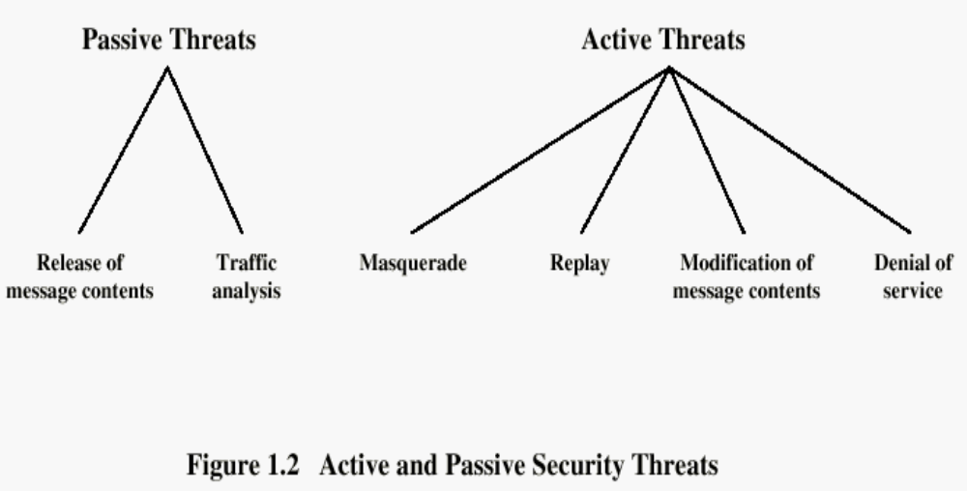

Slide 17
Security Service
  enhance security of data processing systems and information transfers of an organization
  intended to counter security attacks
  using one or more security mechanisms
  often replicates functions normally associated with physical documents
    which, for example, have signatures, dates; need protection from disclosure, tampering, or destruction; be notarized or witnessed; be recorded or licensed
Notes:
Consider the role of a security service, and what may be required.
Note both similarities and differences with traditional paper documents, which for example:
have signatures & dates;
need protection from disclosure, tampering, or destruction;
may be notarized or witnessed;
may be recorded or licensed

Slide 18
Security Services
X.800:
  “a service provided by a protocol layer of communicating open systems, which ensures adequate security of the systems or of data transfers”
RFC 2828:
  “a processing or communication service provided by a system to give a specific kind of protection to system resources”
Notes:
Also have a couple of definition of “security services” from relevant standards. X.800 defines a security service as a service provided by a protocol layer of communicating open systems, which ensures adequate security of the systems or of data transfers. Perhaps a clearer definition is found in RFC 2828, which provides the following definition: a processing or communication service that is provided by a system to give a specific kind of protection to system resources; security services implement security policies and are implemented by security mechanisms.

Slide 19
Security Services (X.800)
Authentication - assurance that the communicating entity is the one claimed
Access Control - prevention of the unauthorized use of a resource
Data Confidentiality –protection of data from unauthorized disclosure
Data Integrity - assurance that data received is as sent by an authorized entity
Non-Repudiation - protection against denial by one of the parties in a communication
Notes:
This list includes the various "classic" security services which are traditionally discussed.
Note there is a degree of ambiguity as to the meaning of these terms, and overlap in their use.
See Stallings Table 1.2 for details of the 5 Security Service categories and the 14 specific services given in X.800.

Slide 20
Security Mechanism
feature designed to detect, prevent, or recover from a security attack
no single mechanism that will support all services required
however one particular element underlies many of the security mechanisms in use:
  cryptographic techniques
hence our focus on this topic
Notes:
Now introduce “Security Mechanism” which are the specific means of implementing one or more security services.
Note these mechanisms span a wide range of technical components, but one aspect seen in many is the use of cryptographic techniques.

Slide 21
Security Mechanisms (X.800)
specific security mechanisms:
  encipherment, digital signatures, access controls, data integrity, authentication exchange, traffic padding, routing control, notarization
pervasive security mechanisms:
  trusted functionality, security labels, event detection, security audit trails, security recovery
Notes:
Some examples of mechanisms from X.800. Note that the “specific security mechanisms” are protocol layer specific, whilst the “pervasive security mechanisms” are not. We will meet some of these mechanisms in much greater detail later.
See Stallings Table 1.3 for details of these mechanisms in X.800, and Table 1.4 for the relationship between services and mechanisms.

Slide 22

Model for Network Security
Notes:
In considering the place of encryption, its useful to use the following two models from Stallings section 1.6.
The first, illustrated in Figure 1.5, models information flowing over an insecure communications channel, in the presence of possible opponents. Hence an appropriate security transform (encryption algorithm) can be used, with suitable keys, possibly negotiated using the presence of a trusted third party.

Slide 23
Model for Network Security
using this model requires us to:
  design a suitable algorithm for the security transformation
  generate the secret information (keys) used by the algorithm
  develop methods to distribute and share the secret information
  specify a protocol enabling the principals to use the transformation and secret information for a security service
Notes:
This general model shows that there are four basic tasks in designing a particular security service, as listed.

Slide 24

Model for Network Access Security
Notes:
The second, illustrated in Figure 1.6, model is concerned with controlled access to information or resources on a computer system, in the presence of possible opponents. Here appropriate controls are needed on the access and within the system, to provide suitable security. Some cryptographic techniques are useful here also.

Slide 25
Model for Network Access Security
using this model requires us to:
  select appropriate gatekeeper functions to identify users
  implement security controls to ensure only authorised users access designated information or resources
trusted computer systems may be useful to help implement this model
Notes:
Detail here the tasks needed to use this model.
Note that trusted computer systems (discussed in Ch 20 can be useful here).

Slide 27
Chapter 2
Classical Encryption Techniques

Slide 28
Cryptography
Cryptography is the study of
  Secret (crypto-) writing (-graphy)
Concerned with developing algorithms:
  Conceal the context of some message from all except the sender and recipient (privacy or secrecy), and/or
  Verify the correctness of a message to the recipient (authentication)
  Form the basis of many technological solutions to computer and communications security problems

Slide 29
Cryptography
Basic idea: convert clear text (also called plain text – the original message) to ciphertext (the encrypted message)‏
        ciphertext = encrypt(plaintext, K_{E})‏
        plaintext = decrypt(ciphertext, K_{C})‏
Can either make the encryption process hidden, so that an intruder cannot know it
Or, can use a known technique and use a hidden key
Notes:
So far all the cryptosystems discussed have been private/secret/single key (symmetric) systems. All classical, and modern block and stream ciphers are of this form.

Slide 30
Some Basic Terminology
plaintext - original message
ciphertext - coded message
cipher - algorithm for transforming plaintext to ciphertext
key - info used in cipher known only to sender/receiver
encipher (encrypt) - converting plaintext to ciphertext
decipher (decrypt) - recovering plaintext from ciphertext
cryptography - study of encryption principles/methods
cryptanalysis (codebreaking) - study of principles/ methods of deciphering ciphertext without knowing key
cryptology - field of both cryptography and cryptanalysis
Notes:
Briefly review some terminology used throughout the course.

Slide 31
Cryptography
characterize cryptographic system by:
  type of encryption operations used
    substitution / transposition / product
  number of keys used
    single-key or private / two-key or public
  way in which plaintext is processed
    block / stream
Notes:
Cryptographic systems can be characterized along these three independent dimensions.

Slide 32
Number of keys used (Secret-Key Cryptography)‏
traditional secret/single key cryptography uses one key
shared by both sender and receiver
if this key is disclosed communications are compromised
also is symmetric, parties are equal
hence does not protect sender from receiver forging a message & claiming is sent by sender
Notes:
So far all the cryptosystems discussed have been private/secret/single key (symmetric) systems. All classical, and modern block and stream ciphers are of this form.

Slide 33
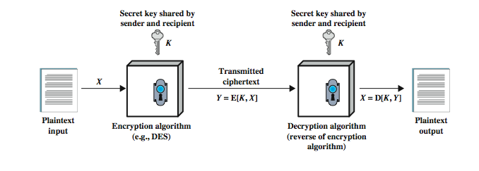
Symmetric Encryption

Slide 34
Public-Key Cryptography
probably most significant advance in the 3000 year history of cryptography
uses two keys – a public & a private key
asymmetric since parties are not equal
uses clever application of number theoretic concepts to function
complements rather than replaces secret key cryptography
Notes:
Will now discuss the radically different public key systems, in which two keys are used. Anyone knowing the public key can encrypt messages or verify signatures, but cannot decrypt messages or create signatures, counter-intuitive though this may seem. It works by the clever use of number theory problems that are easy one way but hard the other. Note that public key schemes are neither more secure than private key (security depends on the key size for both), nor do they replace private key schemes (they are too slow to do so), rather they complement them.

Slide 35
Public-Key Cryptography
public-key/two-key/asymmetric cryptography involves the use of two keys:
  a public-key, which may be known by anybody, and can be used to encrypt messages, and verify signatures
  a private-key, known only to the recipient, used to decrypt messages, and sign (create) signatures
is asymmetric because
  those who encrypt messages or verify signatures cannot decrypt messages or create signatures

Slide 36

Public-Key Cryptography
Notes:
Stallings Fig 9.1

Slide 37
Way in which plaintext is processed
Simplest Stream Cipher
Key
Key
Plaintext
Ciphertext
Plaintext
Ciphertext

Slide 38
Simple Secret-Key Example
P = “abra” which has the binary representation: 01100001011000100011100101100001
Choose a random string of bits as the key
10011101010010001111010101011100
Can use a simple XOR of the binary to get C
11111100001010101000011100111101
To get P back, use the same algorithm and key!
The most popular secret key encryption today is DES.
Notes:
So far all the cryptosystems discussed have been private/secret/single key (symmetric) systems. All classical, and modern block and stream ciphers are of this form.

Slide 39
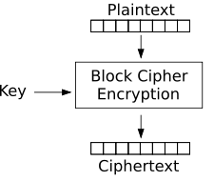
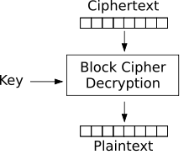
Block Cipher

Slide 40
Type of encryption operations used
Substitution Technique
Caesar Cipher
replaces each letter by 3rd letter on
can define transformation as:
  a b c d e f g h i j k l m n o p q r s t u v w x y z
  D E F G H I J K L M N O P Q R S T U V W X Y Z A B C
mathematically give each letter a number
  a b c d e f g h i j k l m n o p q r s t u v w x y z
  0 1 2 3 4 5 6 7 8 9 10 11 12 13 14 15 16 17 18 19 20 21 22 23 24 25
then have Caesar cipher as:
  c = E(p) = (p + k) mod (26)‏
  p = D(c) = (c – k) mod (26)‏
Notes:
This mathematical description uses modulo (clock) arithmetic. Here, when you reach Z you go back to A and start again. Mod 26 implies that when you reach 26, you use 0 instead (ie the letter after Z, or 25 + 1 goes to A or 0).
Example: howdy (7,14,22,3,24) encrypted using key f (ie a shift of 5) is MTBID

Slide 41
Playfair Cipher
s
i/j
m
p
l
e
a
b
c
d
f
g
h
k
n
o
q
r
t
u
v
w
x
y
z
Key: simple

Slide 42
Playfair Cipher
Use filler letter to separate repeated letters
Encrypt two letters together
  Same row– followed letters
    ac--bd
  Same column– letters under
    qw--wi
  Otherwise—square’s corner at same row
    ar--bq

Slide 43

Hill Cipher
takes m successive plaintext letters and substitutes for them m ciphertext letters
substitution determined by m liner equations, C=KP mod 26
This example will rely on some linear algebra and some number theory. The 'key' for a hill cipher is a matrix e.g.

Slide 44

In the above case, we have taken the size to be 3x3, however it can be any size (as long as it is square).
We now take 3 characters from our plaintext e.g. 'DEF' and create a vector that corresponds to the letters (replace 'A' with 0, 'B' with 1 etc.) to get: [3 4 5] (this is ['D' 'E' 'F']).
To get our ciphertext we perform a matrix multiplication

Slide 45
e.g. for m = 3
c₁=(k₁₁p₁+k₁₂p₂+k₁₃p₃) mod 26
c₂=(k₂₁p₁+k₂₂p₂+k₂₃p₃) mod 26
c₃=(k₃₁p₁+k₃₂p₂+k₃₃p₃) mod 26

Slide 46
Polyalphabetic Ciphers
Basically multiple Caesar ciphers
key is multiple letters long
  K = k₁ k₂ ... k_{d}
  ith letter specifies ith alphabet to use
  mathematically give each letter a number
  a b c d e f g h i j k l m n o p q r s t u v w x y z
  0 1 2 3 4 5 6 7 8 9 10 11 12 13 14 15 16 17 18 19 20 21 22 23 24 25
Plaintext THISPROCESSCANALSOBEEXPRESSED Keyword CIPHERCIPHERCIPHERCIPHERCIPHE
Ciphertext VPXZTIQKTZWTCVPSWFDMTETIGAHLH
Notes:
One approach to reducing the "spikyness" of natural language text is used the Playfair cipher which encrypts more than one letter at once. We now consider the other alternative, using multiple cipher alphabets in turn. This gives the attacker more work, since many alphabets need to be guessed, and because the frequency distribution is more complex, since the same plaintext letter could be replaced by several ciphertext letters, depending on which alphabet is used. The general name for this approach is a polyalphabetic substitution cipher. All these techniques have the following features in common:
A set of related monoalphabetic substitution rules is used.
2. A key determines which particular rule is chosen for a given transformation.

Slide 47
Autokey Cipher
An autokey cipher, or self-synchronizing stream cipher, is a cipher which incorporates the message into the key.
In order to encrypt a letter, one locates the line starting with the letter to be encrypted, and the column beginning with the next letter of the key. The letter where the line and column cross is the ciphertext letter.
Notes:
Taking the polyalphabetic idea to the extreme, want as many different translation alphabets as letters in the message being sent. One way of doing this with a smallish key, is to use the Autokey cipher.
The example uses the keyword "DECEPTIVE" prefixed to as much of the message "WEAREDISCOVEREDSAV" as is needed. When deciphering, recover the first 9 letters using the keyword "DECEPTIVE". Then instead of repeating the keyword, start using the recovered letters from the message "WEAREDISC". As recover more letters, have more of key to recover later letters.
Problem is that the same language characteristics are used by the key as the message. ie. a key of 'E' will be used more often than a 'T' etc hence an 'E' encrypted with a key of 'E' occurs with probability (0.1275)2 = 0.01663, about twice as often as a 'T' encrypted with a key of 'T' have to use a larger frequency table, but it exists given sufficient ciphertext this can be broken.

Slide 48
  For example, if the plaintext is MEET ME FOR LUNCH and the key is RESTAURANT, the first letter of the ciphertext is D, because the M and R intersect at D. The second ciphertext character is I, where the E from MEET and the E from RESTAURANT intersect in the table.
  more secure way to generate the key is to append the plaintext to it. This method makes frequency counting more difficult, as the key does not follow a simple repeating pattern:
  a b c d e f g h i j k l m n o p q r s t u v w x y z
  0 1 2 3 4 5 6 7 8 9 10 11 12 13 14 15 16 17 18 19 20 21 22 23 24 25
Plaintext: MEETMEFORLUNCH
Key: RESTAURANTMEET
Ciphertext: DIWMMYWOEEGRGA

Slide 49
One-Time Pad
In cryptography, the one-time pad (OTP) is an encryption algorithm in which the plaintext is combined with a secret random key or pad, which is used only once.
The key is truly random, as large as the plaintext, never reused in whole or part, and kept secret.
You have a message M, and you compute the ciphertext C by XORing the message with the OTP:
C = M xor OTP
Notes:
The One-Time Pad is an evolution of the Vernham cipher, which was invented by Gilbert Vernham in 1918, and used a long tape of random letters to encrypt the message. An Army Signal Corp officer, Joseph Mauborgne, proposed an improvement using a random key that was truly as long as the message, with no repetitions, which thus totally obscures the original message. It produces random output that bears no statistical relationship to the plaintext. Because the ciphertext contains no information whatsoever about the plaintext, there is simply no way to break the code, since any plaintext can be mapped to any ciphertext given some key.
The one-time pad offers complete security but, in practice, has two fundamental difficulties:
There is the practical problem of making large quantities of random keys.
2. And the problem of key distribution and protection, where for every message to be sent, a key of equal length is needed by both sender and receiver.
Because of these difficulties, the one-time pad is of limited utility, and is useful primarily for low-bandwidth channels requiring very high security.

Slide 50
Transposition Ciphers
now consider classical transposition or permutation ciphers
these hide the message by rearranging the letter order
without altering the actual letters used
Notes:
All the techniques examined so far involve the substitution of a ciphertext symbol for a plaintext symbol. A very different kind of mapping is achieved by performing some sort of permutation on the plaintext letters. This technique is referred to as a transposition cipher, and form the second basic building block of ciphers. The core idea is to rearrange the order of basic units (letters/bytes/bits) without altering their actual values.

Slide 51
Transposition Ciphers
A cipher, or a component of a more complicated cipher, that involves the symbol at each place in the plaintext being moved to a newly decided (and often different) place, i.e. within each block of plaintext the positional indices of the symbol places are changed according to some plan.
Notes:
All the techniques examined so far involve the substitution of a ciphertext symbol for a plaintext symbol. A very different kind of mapping is achieved by performing some sort of permutation on the plaintext letters. This technique is referred to as a transposition cipher, and form the second basic building block of ciphers. The core idea is to rearrange the order of basic units (letters/bytes/bits) without altering their actual values.

Slide 52
Product Ciphers
ciphers using substitutions or transpositions are not secure because of language characteristics
hence consider using several ciphers in succession to make harder, but:
  two substitutions make a more complex substitution
  two transpositions make more complex transposition
  but a substitution followed by a transposition makes a new much harder cipher
this is bridge from classical to modern ciphers
Notes:
Have seen that ciphers based on just substitutions or transpositions are not secure, and can be attacked because they do not sufficient obscure the underlying language structure
So consider using several ciphers in succession to make harder.
A substitution followed by a transposition is known as a Product Cipher, and makes a new much more secure cipher, and forms the bridge to modern ciphers.

Slide 53
Network Security
Chapter 3 – “Block Ciphers and the Data Encryption Standard”

Slide 54
Block Ciphers and the Data Encryption Standard

Slide 55
Block vs Stream Ciphers
block ciphers process messages in blocks, each of which is then en/decrypted
like a substitution on very big characters
  64-bits or more
stream ciphers process messages a bit or byte at a time when en/decrypting
many current ciphers are block ciphers
broader range of applications
Notes:
Block ciphers work a on block / word at a time, which is some number of bits. All of these bits have to be available before the block can be processed. Stream ciphers work on a bit or byte of the message at a time, hence process it as a “stream”. Block ciphers are currently better analysed, and seem to have a broader range of applications, hence focus on them.

Slide 56
Simplest Stream Cipher
Key
Key
Plaintext
Ciphertext
Plaintext
Ciphertext

Slide 57
Block Cipher

Slide 58
Block Cipher Principles
most symmetric block ciphers are based on a Feistel Cipher Structure
needed since must be able to decrypt ciphertext to recover messages efficiently
block ciphers look like an extremely large substitution
would need table of 2⁶⁴ entries for a 64-bit block
instead create from smaller building blocks
using idea of a product cipher
Notes:
Most symmetric block encryption algorithms in current use are based on a structure referred to as a Feistel block cipher. A block cipher operates on a plaintext block of n bits to produce a ciphertext block of n bits. An arbitrary reversible substitution cipher for a large block size is not practical, however, from an implementation and performance point of view. In general, for an n-bit general substitution block cipher, the size of the key is n x 2^{n}. For a 64-bit block, which is a desirable length to thwart statistical attacks, the key size is 64 x 2⁶⁴ = 2⁷⁰ = 10²¹ bits. In considering these difficulties, Feistel points out that what is needed is an approximation to the ideal block cipher system for large n, built up out of components that are easily realizable.

Slide 59
Claude Shannon and Substitution-Permutation Ciphers
Claude Shannon introduced idea of substitution-permutation (S-P) networks in 1949 paper
form basis of modern block ciphers
S-P nets are based on the two primitive cryptographic operations seen before:
  substitution (S-box)
  permutation (P-box)
provide confusion & diffusion of message & key
Notes:
Claude Shannon’s 1949 paper has the key ideas that led to the development of modern block ciphers. Critically, it was the technique of layering groups of S-boxes separated by a larger P-box to form the S-P network, a complex form of a product cipher. He also introduced the ideas of confusion and diffusion, notionally provided by S-boxes and P-boxes (in conjunction with S-boxes).

Slide 60
Confusion and Diffusion
cipher needs to completely obscure statistical properties of original message
a one-time pad does this
more practically Shannon suggested combining S & P elements to obtain:
diffusion – dissipates statistical structure of plaintext over bulk of ciphertext
confusion – makes relationship between ciphertext and key as complex as possible
Notes:
The terms diffusion and confusion were introduced by Claude Shannon to capture the two basic building blocks for any cryptographic system. Every block cipher involves a transformation of a block of plaintext into a block of ciphertext, where the transformation depends on the key. The mechanism of diffusion seeks to make the statistical relationship between the plaintext and ciphertext as complex as possible in order to thwart attempts to deduce the key. Confusion seeks to make the relationship between the statistics of the ciphertext and the value of the encryption key as complex as possible, again to thwart attempts to discover the key.
So successful are diffusion and confusion in capturing the essence of the desired attributes of a block cipher that they have become the cornerstone of modern block cipher design.

Slide 61
Feistel Cipher Structure
Horst Feistel devised the feistel cipher
  based on concept of invertible product cipher
partitions input block into two halves
  process through multiple rounds which
  perform a substitution on left data half
  based on round function of right half & subkey
  then have permutation swapping halves
implements Shannon’s S-P net concept
Notes:
Horst Feistel, working at IBM Thomas J Watson Research Labs devised a suitable invertible cipher structure in early 70's.
One of Feistel's main contributions was the invention of a suitable structure which adapted Shannon's S-P network in an easily inverted structure. It partitions input block into two halves which are processed through multiple rounds which perform a substitution on left data half, based on round function of right half & subkey, and then have permutation swapping halves. Essentially the same h/w or s/w is used for both encryption and decryption, with just a slight change in how the keys are used. One layer of S-boxes and the following P-box are used to form the round function.

Slide 62
Feistel Network
iterated cipher mapping (L₀, R₀) to (R_{r}, L_{r}) through r-round process, (L_{i−1}, R_{i−1}) →_{Ki} (L_{i}, R_{i}) as follows
  L_{i} = R_{i−1}, R_{i} = L_{i−1} ⊕ f(R_{i−1}, K_{i}), K_{i} is derived from K
L_{i-1}
R_{i-1}
f
K_{i}
L_{i}
R_{i}

Slide 63
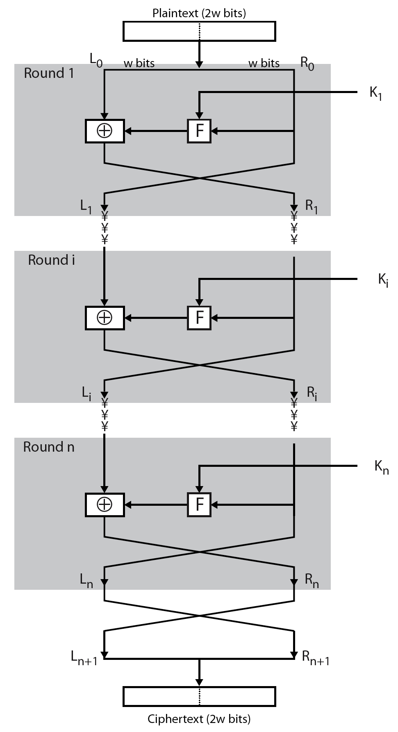
Feistel Cipher Structure
Notes:
Stallings Figure 3.2 illustrates the classical feistel cipher structure, with data split in 2 halves, processed through a number of rounds which perform a substitution on left half using output of round function on right half & key, and a permutation which swaps halves, as listed previously.

Slide 64
Feistel Cipher Structure
Block size: larger block sizes mean greater security
Key Size: larger key size means greater security
Number of rounds: multiple rounds offer increasing security
Subkey generation algorithm: greater complexity will lead to greater difficulty of cryptanalysis.
Fast software encryption/decryption: the speed of execution of the algorithm becomes a concern

Slide 65
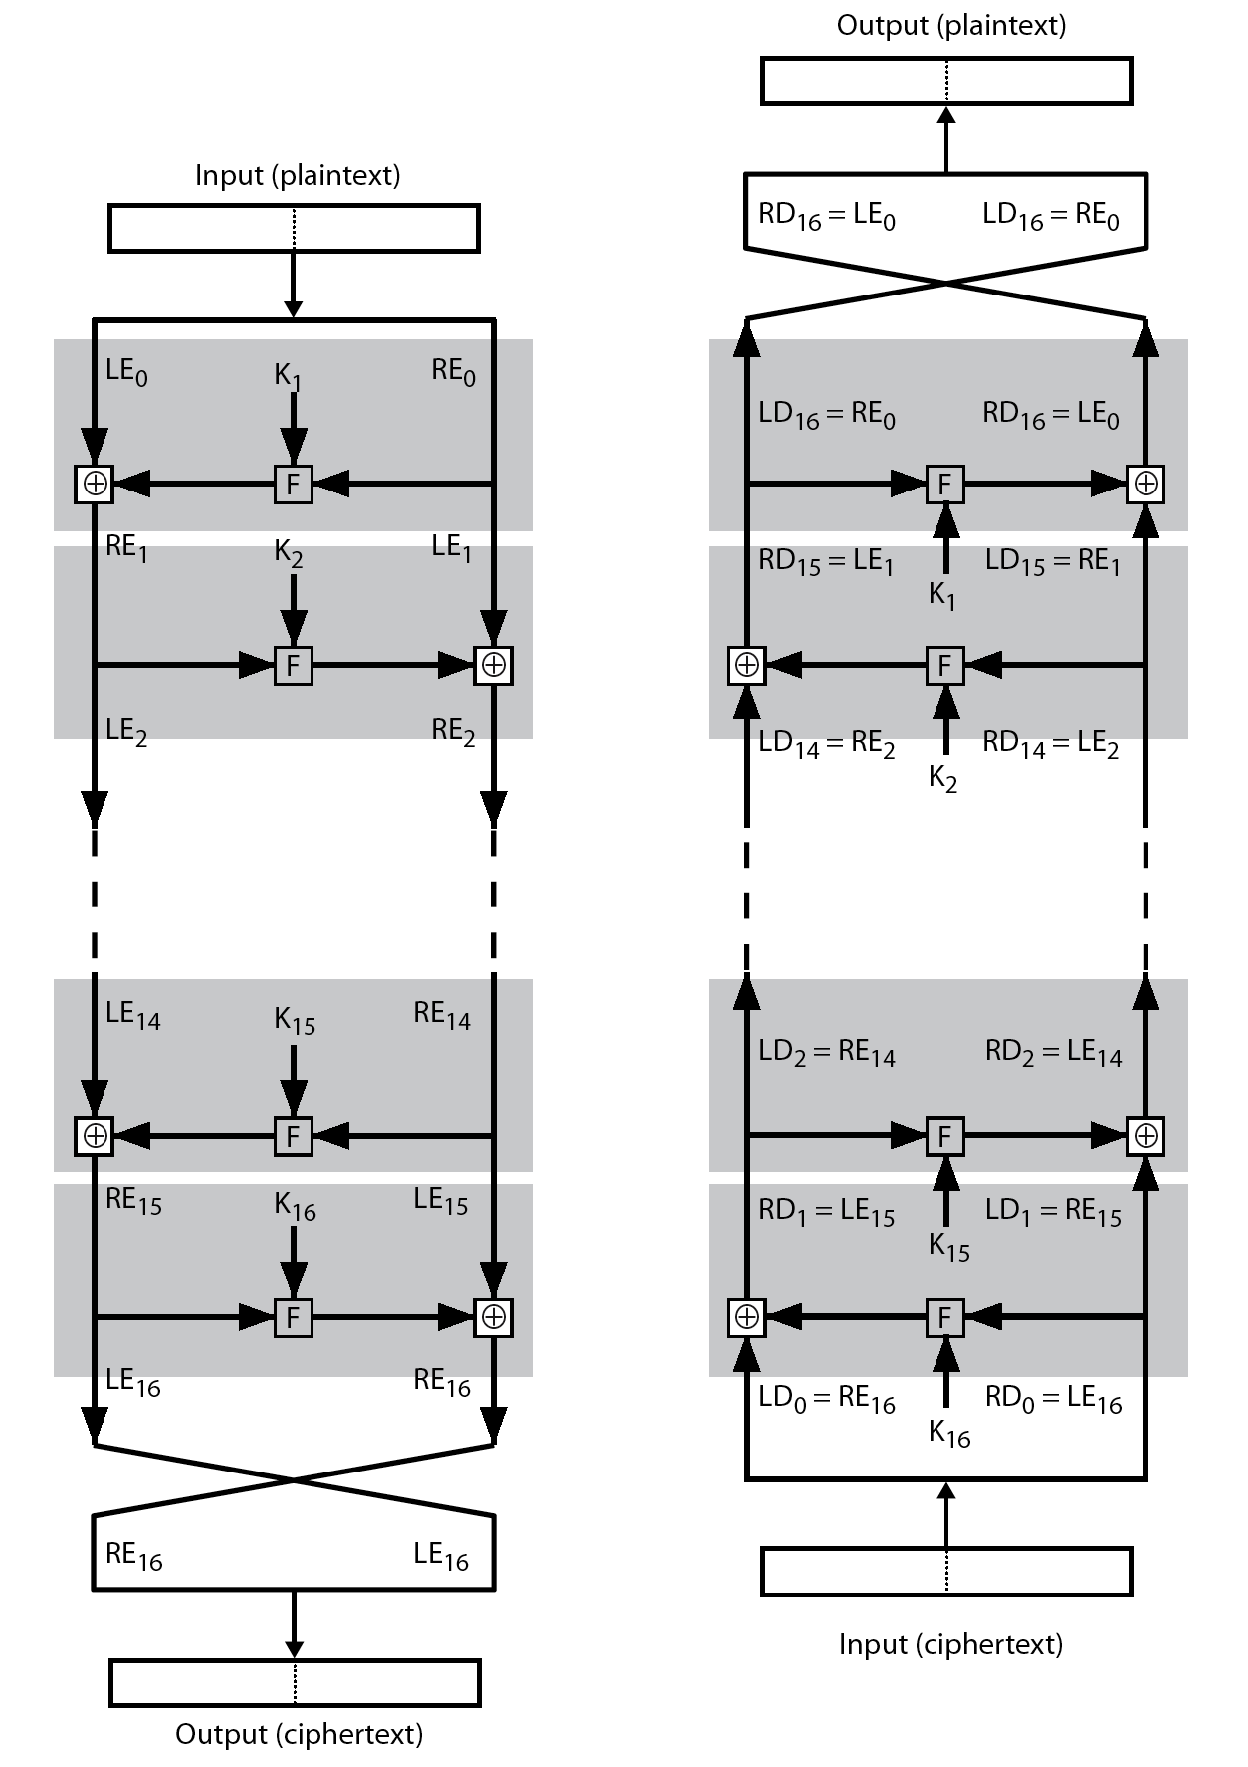
Feistel Cipher Decryption
Notes:
The process of decryption with a Feistel cipher, as shown in Stallings Figure 3.3, is essentially the same as the encryption process. The rule is as follows: Use the ciphertext as input to the algorithm, but use the subkeys Ki in reverse order. That is, use Kn in the first round, Kn–1 in the second round, and so on until K1 is used in the last round. This is a nice feature because it means we need not implement two different algorithms, one for encryption and one for decryption.

Slide 66
Data Encryption Standard (DES)
most widely used block cipher in world
adopted in 1977 by NBS (now NIST)
  as FIPS PUB 46
encrypts 64-bit data using 56-bit key
has widespread use
has been considerable controversy over its security
Notes:
The most widely used private key block cipher, is the Data Encryption Standard (DES). It was adopted in 1977 by the National Bureau of Standards as Federal Information Processing Standard 46 (FIPS PUB 46). DES encrypts data in 64-bit blocks using a 56-bit key. The DES enjoys widespread use. It has also been the subject of much controversy its security.

Slide 67
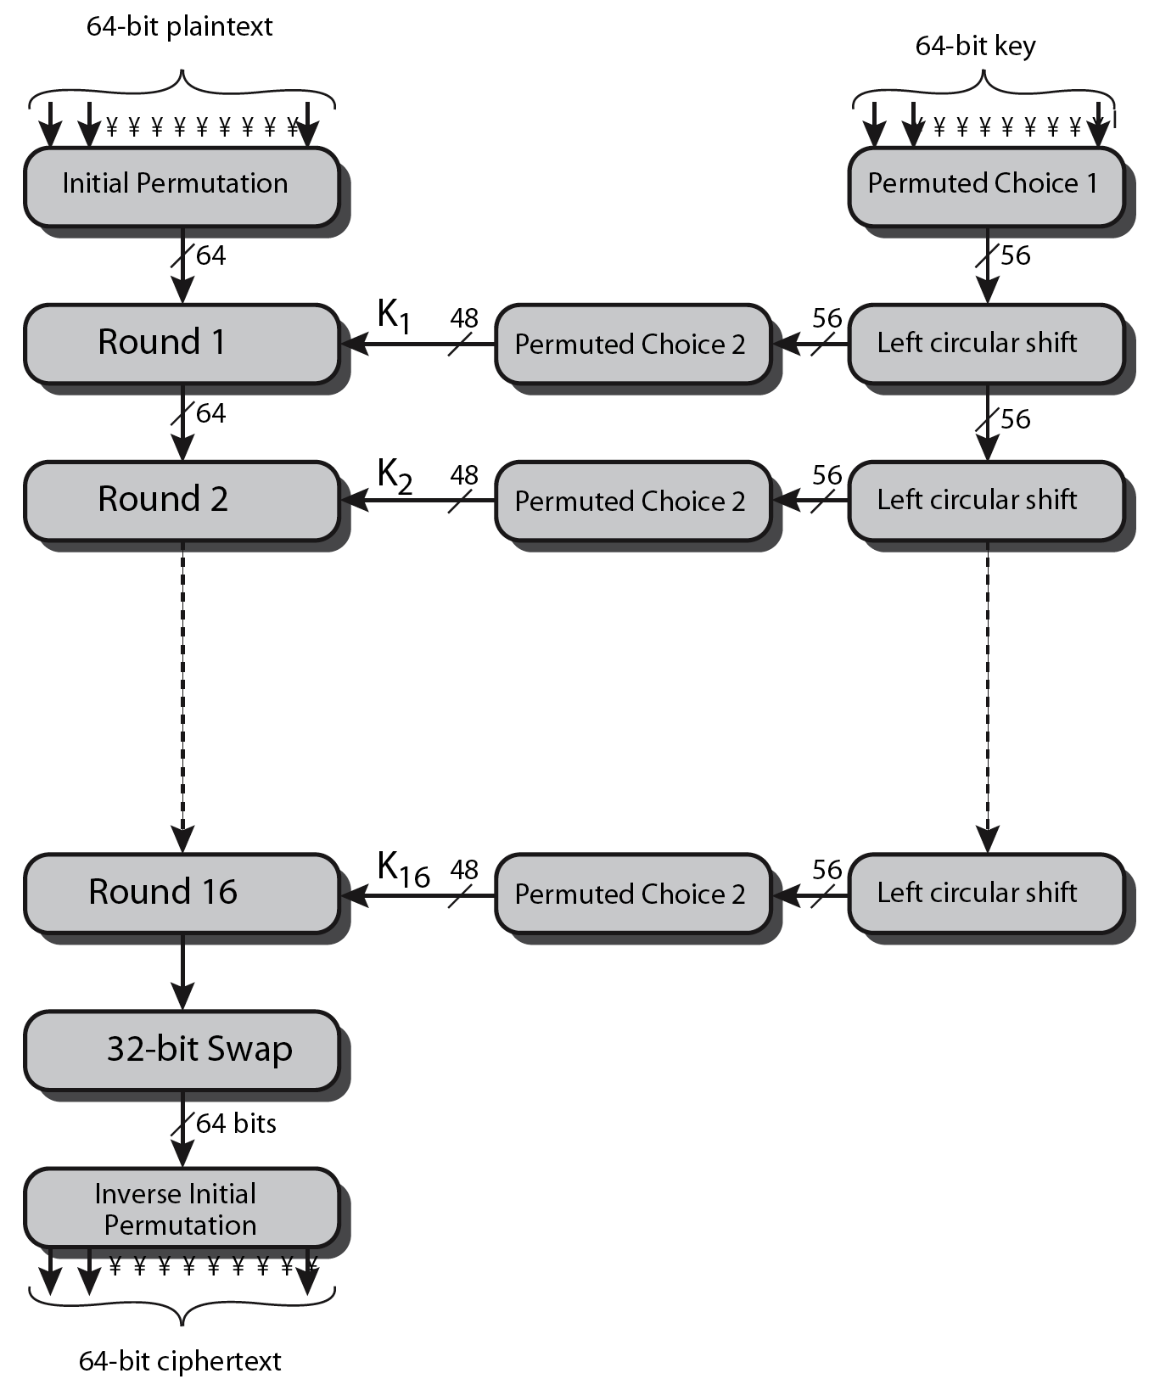
DES Encryption Overview
Notes:
The overall scheme for DES encryption is illustrated in Stallings Figure3.7, which takes as input 64-bits of data and of key.
The left side shows the basic process for enciphering a 64-bit data block which consists of:
- an initial permutation (IP) which shuffles the 64-bit input block
- 16 rounds of a complex key dependent round function involving substitutions & permutations
- a final permutation, being the inverse of IP
The right side shows the handling of the 56-bit key and consists of:
- an initial permutation of the key (PC1) which selects 56-bits out of the 64-bits input, in two 28-bit halves
- 16 stages to generate the 48-bit subkeys using a left circular shift and a permutation of the two 28-bit halves

Slide 68
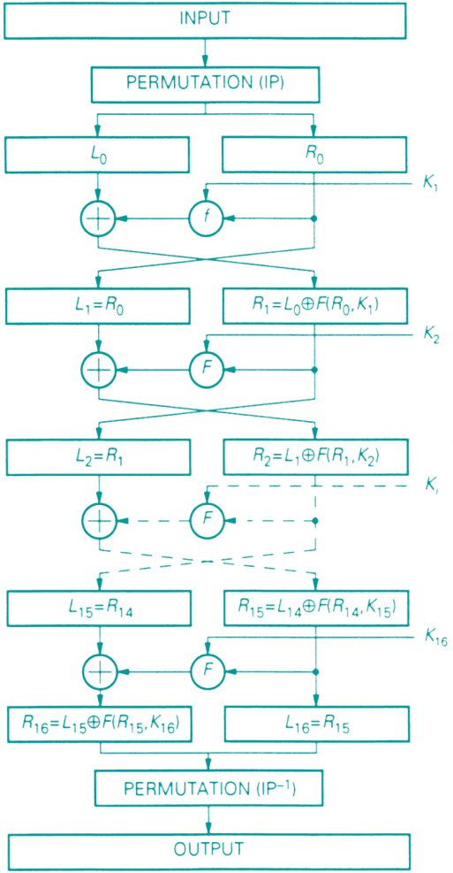
DES

Slide 69
DES Round Structure
uses two 32-bit L & R halves
as for any Feistel cipher can describe as:
  L_{i} = R_{i–1}
  R_{i} = L_{i–1} ⊕ F(R_{i–1}, K_{i})
F takes 32-bit R half and 48-bit subkey:
  expands R to 48-bits using perm E
  adds to subkey using XOR
  passes through 8 S-boxes to get 32-bit result
  finally permutes using 32-bit perm P
Notes:
Detail here the internal structure of the DES round function F, which takes R half & subkey, and processes them through E, add subkey, S & P.
This follows the classic structure for a feistel cipher.
Note that the s-boxes provide the “confusion” of data and key values, whilst the permutation P then spreads this as widely as possible, so each S-box output affects as many S-box inputs in the next round as possible, giving “diffusion”.

Slide 70
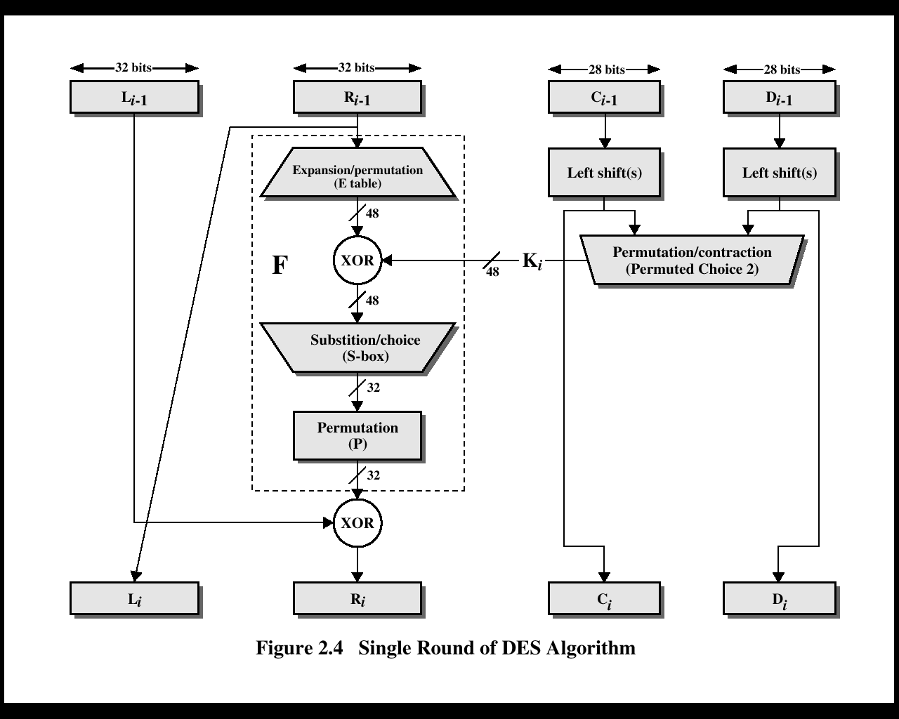
Notes:
The overall scheme for DES encryption is illustrated in Stallings Figure3.7, which takes as input 64-bits of data and of key.
The left side shows the basic process for enciphering a 64-bit data block which consists of:
- an initial permutation (IP) which shuffles the 64-bit input block
- 16 rounds of a complex key dependent round function involving substitutions & permutations
- a final permutation, being the inverse of IP
The right side shows the handling of the 56-bit key and consists of:
- an initial permutation of the key (PC1) which selects 56-bits out of the 64-bits input, in two 28-bit halves
- 16 stages to generate the 48-bit subkeys using a left circular shift and a permutation of the two 28-bit halves

Slide 71
Initial Permutation IP
first step of the data computation
IP reorders the input data bits
even bits to LH half, odd bits to RH half
The values in each matrix identify where each bit of the input message is mapped to in the output message. For example, The matrix for IP shows that the 58th bit from the input gets mapped to the first bit of the output; the 50th of the input maps to the second of the output, and so on.
Notes:
The initial permutation and its inverse are defined by tables, as shown in Stallings Tables 3.2a and 3.2b, respectively. The tables are to be interpreted as follows. The input to a table consists of 64 bits numbered left to right from 1 to 64. The 64 entries in the permutation table contain a permutation of the numbers from 1 to 64. Each entry in the permutation table indicates the position of a numbered input bit in the output, which also consists of 64 bits.
Note that the bit numbering for DES reflects IBM mainframe practice, and is the opposite of what we now mostly use - so be careful! Numbers from Bit 1 (leftmost, most significant) to bit 32/48/64 etc (rightmost, least significant).
Note that examples are specified using hexadecimal.
Here a 64-bit plaintext value of “675a6967 5e5a6b5a” (written in left & right halves) after permuting with IP becomes “ffb2194d 004df6fb”.

Slide 72
IP |  |  |  |  |  |  |  |  | IP⁻¹
58 | 50 | 42 | 34 | 26 | 18 | 10 | 2 |  | 40 | 8 | 48 | 16 | 56 | 24 | 64 | 32
60 | 52 | 44 | 36 | 28 | 20 | 12 | 4 |  | 39 | 7 | 47 | 15 | 55 | 23 | 63 | 31
62 | 54 | 46 | 38 | 30 | 22 | 14 | 6 |  | 38 | 6 | 46 | 14 | 54 | 22 | 62 | 30
64 | 56 | 48 | 40 | 32 | 24 | 16 | 8 |  | 37 | 5 | 45 | 13 | 53 | 21 | 61 | 29
57 | 49 | 41 | 33 | 25 | 17 | 9 | 1 |  | 36 | 4 | 44 | 12 | 52 | 20 | 60 | 28
59 | 51 | 43 | 35 | 27 | 19 | 11 | 3 |  | 35 | 3 | 43 | 11 | 51 | 19 | 59 | 27
61 | 53 | 45 | 37 | 29 | 21 | 13 | 5 |  | 34 | 2 | 42 | 10 | 50 | 18 | 58 | 26
63 | 55 | 47 | 39 | 31 | 23 | 15 | 7 |  | 33 | 1 | 41 | 9 | 49 | 17 | 57 | 25
Table 2. Initial and final permutation matrices for DES.

Slide 73
Expansion Table
Expands the 32 bit data to 48 bits
  Result(i)=input( array(i))
  The expansion table defines a permutation plus an expansion that involves duplication of 16 of the bits.
32 | 1 | 2 | 3 | 4 | 5
4 | 5 | 6 | 7 | 8 | 9
8 | 9 | 10 | 11 | 12 | 13
12 | 13 | 14 | 15 | 16 | 17
16 | 17 | 18 | 19 | 20 | 21
20 | 21 | 22 | 23 | 24 | 25
24 | 25 | 26 | 27 | 28 | 29
28 | 29 | 30 | 31 | 32 | 1

Slide 74
S-Boxes
The resulting 48 bits are XORed with key.
This 48 bit result passes through a substitution function comprising 8 S-boxes.
Which each map 6 input bits to 4 output bits.
Given 6-bits B=b₁b₂b₃b₄b₅b₆,
  Row r=b₁b₆
  Column c=b₂b₃b₄b₅
  S(B)=S(r,c) written in binary of length 4

Slide 75

DES Round Structure
Notes:
Stallings Figure 3.6 illustrates the internal structure of the DES round function F. The R input is first expanded to 48 bits by using expansion table E that defines a permutation plus an expansion that involves duplication of 16 of the R bits (Stallings Table 3.2c). The resulting 48 bits are XORed with Ki. This 48-bit result passes through a substitution function comprising 8 S-boxes which each map 6 input bits to 4 output bits, producing a 32-bit output, which is then permuted by permutation P as defined by Stallings Table 3.2d.

Slide 76
S-Box
6 bit input, 4 bit output
27 = 011011 = (01) (1101)
S₁-Box output for 27 = 5
 | 0 | 1 | 2 | 3 | 4 | 5 | 6 | 7 | 8 | 9 | 10 | 11 | 12 | 13 | 14 | 15
0 | 14 | 4 | 13 | 1 | 2 | 15 | 11 | 8 | 3 | 10 | 6 | 12 | 5 | 9 | 0 | 7
1 | 0 | 15 | 7 | 4 | 14 | 2 | 13 | 1 | 10 | 6 | 12 | 11 | 9 | 5 | 3 | 8
2 | 4 | 1 | 14 | 8 | 13 | 6 | 2 | 11 | 15 | 12 | 9 | 7 | 3 | 10 | 5 | 0
3 | 15 | 12 | 8 | 2 | 4 | 9 | 1 | 7 | 5 | 11 | 3 | 14 | 10 | 0 | 6 | 13

Slide 77
Permutation Table
The permutation after each round
16 | 7 | 20 | 21
29 | 12 | 28 | 17
1 | 15 | 23 | 26
5 | 18 | 31 | 10
2 | 8 | 24 | 14
32 | 27 | 3 | 9
19 | 13 | 30 | 6
22 | 11 | 4 | 25

Slide 78
DES Key Schedule
The 64 –bit key input is first processed by permuted choice One.
The resulting 56-bit key is then treated as two 28-bit quantities C and D.
In each round forms subkeys
rotating each half separately either 1 or 2 places depending on the key rotation schedule K
    selecting 24-bits from each half & permuting them by PC2 for use in round function F
note practical use issues in h/w vs s/w
Notes:
The DES Key Schedule generates the subkeys needed for each data encryption round. The 64-bit key input is first processed by Permuted Choice One (Stallings Table 3.4b). The resulting 56-bit key is then treated as two 28-bit quantities C & D. In each round, these are separately processed throgh a circular left shift (rotation) of 1 or 2bits as shown in Stallings Table 3.4d. These shifted values serve as input to the next round of the key schedule. They also serve as input to Permuted Choice Two (Stallings Table 3.4c), which produces a 48-bit output that serves as input to the round function F.
The 56 bit key size comes from security considerations as we know now. It was big enough so that an exhaustive key search was about as hard as the best direct attack (a form of differential cryptanalysis called a T-attack, known by the IBM & NSA researchers), but no bigger. The extra 8 bits were then used as parity (error detecting) bits, which makes sense given the original design use for hardware communications links. However we hit an incompatibility with simple s/w implementations since the top bit in each byte is 0 (since ASCII only uses 7 bits), but the DES key schedule throws away the bottom bit! A good implementation needs to be cleverer!

Slide 79
Permutation Tables
57 | 49 | 41 | 33 | 25 | 17 | 9
1 | 58 | 50 | 42 | 34 | 26 | 18
10 | 2 | 59 | 51 | 43 | 35 | 27
19 | 11 | 3 | 60 | 52 | 44 | 36
63 | 55 | 47 | 39 | 31 | 23 | 15
7 | 62 | 54 | 47 | 38 | 30 | 22
14 | 6 | 61 | 53 | 45 | 37 | 29
21 | 13 | 5 | 28 | 20 | 12 | 4
Permutation table P1

Slide 80
After this permutation, the key is split into two halves, C and D. After each round, each half is independently shifted to the left by either one or two bits, depending on which round is executing .The shift is rotational, so that bits that get shifted off of one end get placed back on the other end.
Round | 1 | 2 | 3 | 4 | 5 | 6 | 7 | 8 | 9 | 10 | 11 | 12 | 13 | 14 | 15 | 16
Shifts | 1 | 1 | 2 | 2 | 2 | 2 | 2 | 2 | 1 | 2 | 2 | 2 | 2 | 2 | 2 | 1
Table. Key Shifting Factors for each round of DES.

Slide 81
Finally, the subkey function is used to convert the key into a 48 bit block, to be used in the actual encryption. Again, this is expressed in matrix form, as shown below.
Subkey Permutation
14 | 17 | 11 | 24 | 1 | 5
3 | 28 | 15 | 6 | 21 | 10
23 | 19 | 12 | 4 | 26 | 8
16 | 7 | 27 | 20 | 13 | 2
41 | 52 | 31 | 37 | 47 | 55
30 | 40 | 51 | 45 | 33 | 48
44 | 49 | 39 | 56 | 34 | 53
46 | 42 | 50 | 36 | 29 | 32
.

Slide 82
DES Decryption
decrypt must unwind steps of data computation
with Feistel design, do encryption steps again using subkeys in reverse order (SK16 … SK1)
  IP undoes final FP step of encryption
  1st round with SK16 undoes 16th encrypt round
  ….
  16th round with SK1 undoes 1st encrypt round
  then final FP undoes initial encryption IP
  thus recovering original data value
Notes:
As with any Feistel cipher, DES decryption uses the same algorithm as encryption except that the subkeys are used in reverse order SK16 .. SK1.
If you trace through the DES overview diagram can see how each decryption step top to bottom with reversed subkeys, undoes the equivalent encryption step moving from bottom to top.

Slide 83
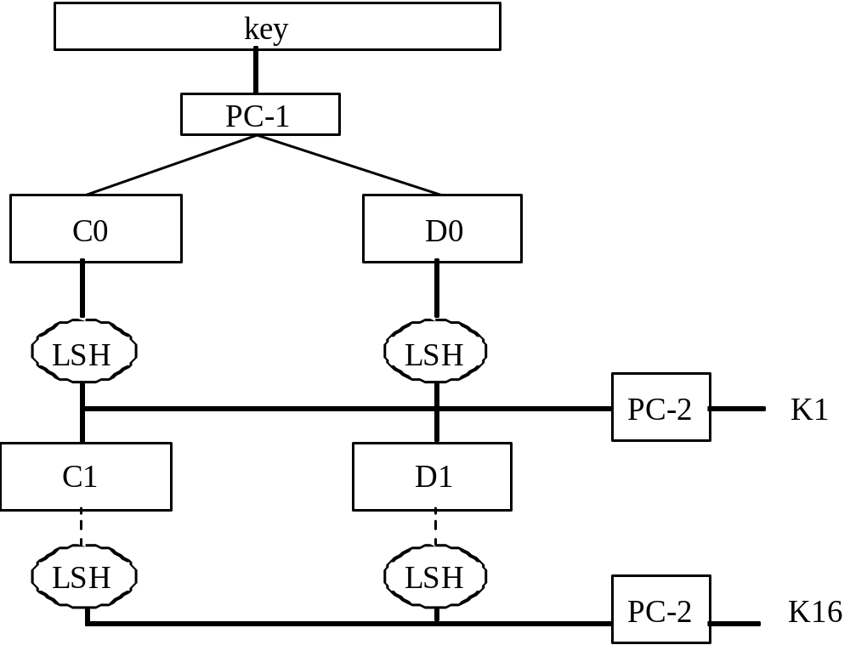
Generation of Round Keys
Round keys are 48 bits each
LSH == left shift
PC-1, PC-2 == permutations
Slide #9-<number>
Notes:
Left shift one or two bits depending on the round
PC-2 is the compression permutation transformation, and it is the same for each round.

Slide 84
Avalanche Effect
A desirable property of any encryption algorithm is that a small change in either the plaintext or the key should produce a significant change in the ciphertext.
In particular, a change in one bit of the plaintext or one bit of the key should produce a change in many bits of the ciphertext.
DES exhibits strong avalanche
Notes:
A desirable property of any encryption algorithm is that a small change in either the plaintext or the key should produce a significant change in the ciphertext. In particular, a change in one bit of the plaintext or one bit of the key should produce a change in many bits of the ciphertext. If the change were small, this might provide a way to reduce the size of the plaintext or key space to be searched. DES exhibits a strong avalanche effect, as may be seen in Stallings Table 3.5.

Slide 85
Strength of DES – Key Size
56-bit keys have 2⁵⁶ = 7.2 x 10¹⁶ values
brute force search looks hard
recent advances have shown is possible
  in 1997 on Internet in a few months
  in 1998 on dedicated h/w Electronic Frontier Foundation (EFF) in a few days
  in 1999 above combined in 22hrs!
still must be able to recognize plaintext
must now consider alternatives to DES
Notes:
Since its adoption as a federal standard, there have been lingering concerns about the level of security provided by DES in two areas: key size and the nature of the algorithm.
With a key length of 56 bits, there are 2^56 possible keys, which is approximately 7.2*10^16 keys. Thus a brute-force attack appeared impractical.
However DES was finally and definitively proved insecure in July 1998, when the Electronic Frontier Foundation (EFF) announced that it had broken a DES encryption using a special-purpose "DES cracker" machine that was built for less than $250,000. The attack took less than three days. The EFF has published a detailed description of the machine, enabling others to build their own cracker [EFF98].
There have been other demonstrated breaks of the DES using both large networks of computers & dedicated h/w, including:
- 1997 on a large network of computers in a few months
- 1998 on dedicated h/w (EFF) in a few days
- 1999 above combined in 22hrs!
It is important to note that there is more to a key-search attack than simply running through all possible keys. Unless known plaintext is provided, the analyst must be able to recognize plaintext as plaintext.
Clearly must now consider alternatives to DES, the most important of which are AES and triple DES.

